Slide 1
Word embeddings
What are embeddings (for), training tasks and models, bias and limitations
Notes:
Correction from last week: "GPT is not for finetuning". That's not true; GPT-1 and GPT-2 are actually available as models on Huggingface that you can fine-tune in the same way that we fine-tuned BERT. And GPT-3 can be fine-tuned via the OpenAI API for money. More correct: "GPT-3-and-up models do not necessarily have to be fine-tuned to be deployed on new tasks".

Slide 2
What are embeddings?

Slide 3
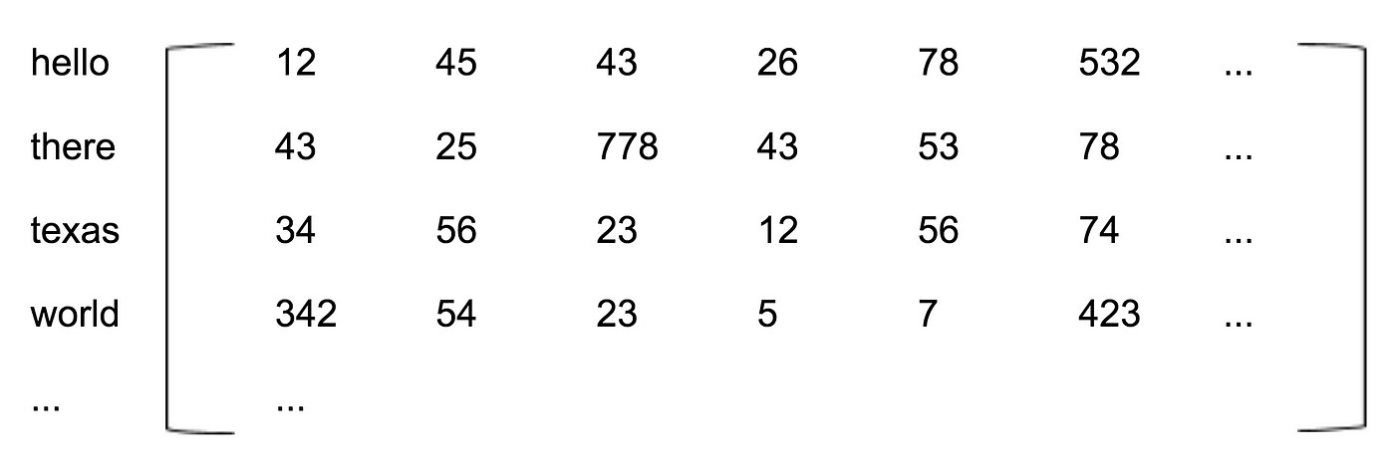

Slide 4
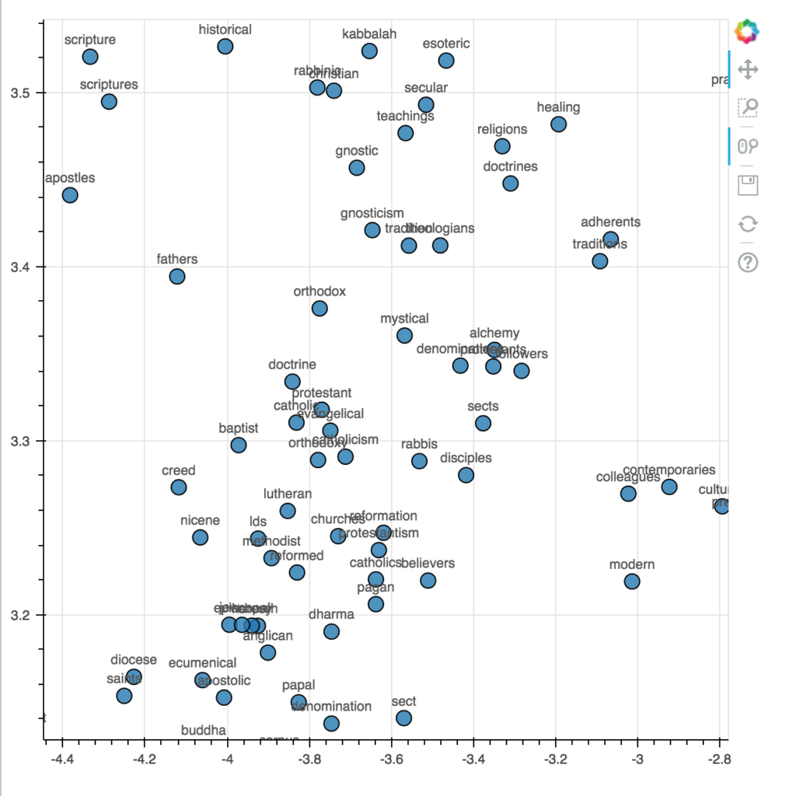
T-SNE
Notes:
Word embeddings are vectors, i.e. lists of numbers, of all the same length. That means we can also imagine the embedding matrix as a very high-dimensional space, where the first number for each word is its location on the first axis, the second number is its location on the second axis, and so on. Of course, we can't actually visualize this, say, 200-dimensional space. But what we can do, is apply an algorithm that tries to preserve as much of the relationships between words as possible while plotting them in a 2D space. T-SNE is such an algorithm. Its details aren't important. You'll be applying T-SNE yourself in the exercise set, to help drive home the understanding that word embeddings are also points in a space. https://nlpforhackers.io/word-embeddings/

Slide 5
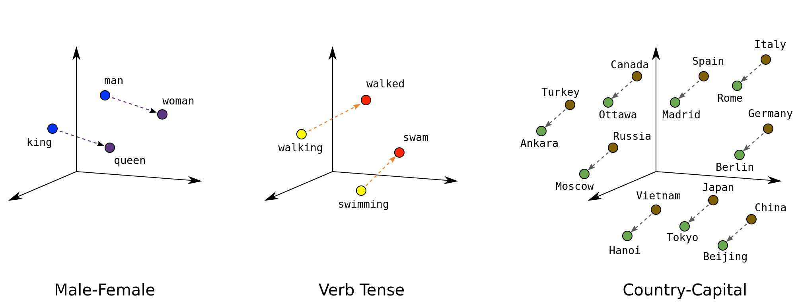
Mikolov et al. (2013)
Notes:
In addition to the fact that word embeddings show us who the "meaning neighbors" of different words are, some of the directions in the embedding space might actually be meaningful. For example, there might be a direction that encodes gender, going from male on one end to female on another. As we will see in a little bit, we might actually be able to do something with these. :) It also means that embeddings have the neat property of being able to solve analogies. So if we were to ask the embedding matrix, "man is to woman as king is to what?", it would be able to give us the answer by looking at the step in space that is needed to go from man to woman, then hopping to king and taking that same step, to find that where it ended up was very close to the embedding for queen.
https://developers.google.com/machine-learning/crash-course/embeddings/translating-to-a-lower-dimensional-space

Slide 6
Why embeddings?

Slide 7
Why embeddings?
1. Input for supervised learning models
Goal: improving performance
Idea:
Feeding the model with denser, more meaningful representations of words

Slide 8
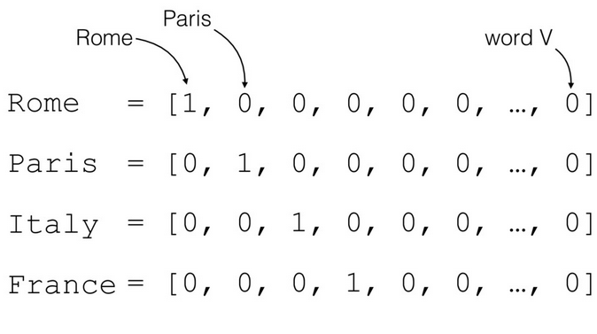
Why embeddings?
1. Input for supervised learning models
Alternative:
One-hot encoding
Notes:
There's no meaning being captured here. Rome is no more similar to Italy than it is to France. https://medium.com/intelligentmachines/word-embedding-and-one-hot-encoding-ad17b4bbe111

Slide 9
Why embeddings?
1. Input for supervised learning models
Some models have enough parameters and training data to deal with one-hot encodings
Derive the meaning on their own -> embedding step is built in
Ex. GPT

Slide 10
Why embeddings?
1. Input for supervised learning models
Other models don't have enough training data to derive meanings
Especially for rare words
So: use embeddings trained on more data as input
Ex. our tweet sentiment analysis RNN with "only" 60.000 tweets as training data

Slide 11
Why embeddings?
2. Objects of interest
Goal: understanding meanings in the underlying corpus
(or using them as variables in further analyses)
Similar to using outputs of unsupervised models
Notes:
Embeddings are produced by supervised (more specifically self-supervised) models. But in this use case of embeddings, we are not interested in the outputs or predictive capacity of those models. We just hope that the embeddings that those models learn capture some interesting meaning dimensions. In that sense, this is similar to unsupervised models, in that we don’t know beforehand what will come out, and there's no obvious benchmark to measure performance against.

Slide 12
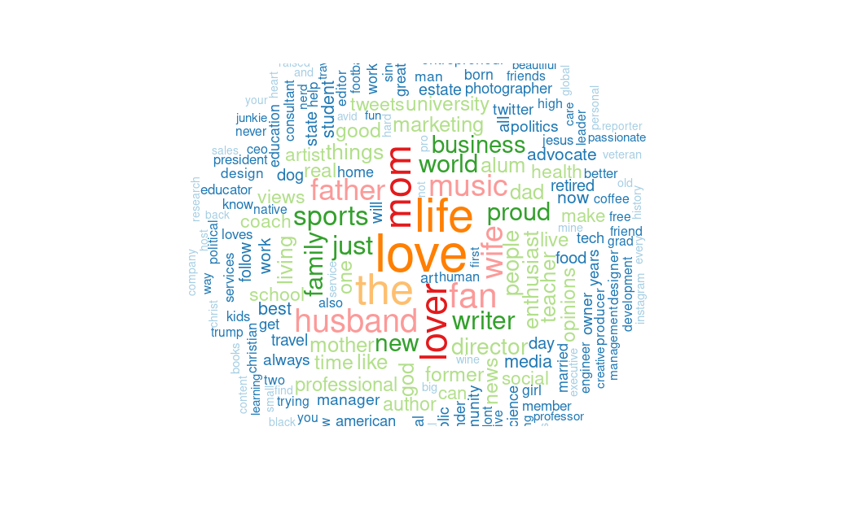
Why embeddings?
2.6 million US Twitter bios
max. 160 characters
recorded daily since June 2020
Notes:
Vandeweerdt, C. et al. (2023) "Using Twitter bios to map Americans' political and non-political identities." Working paper.

Slide 13
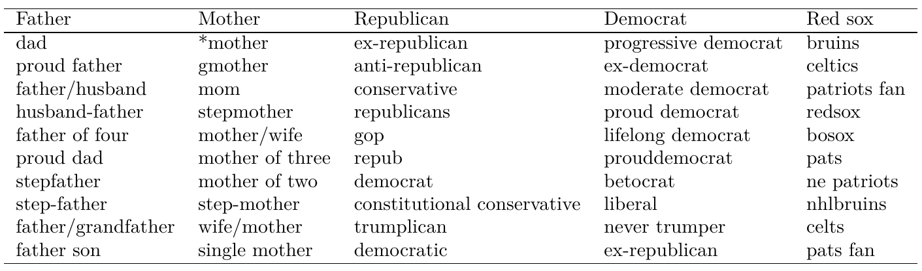
Notes:
FastText with 200 dimensions on the bios recorded on one day

Slide 14
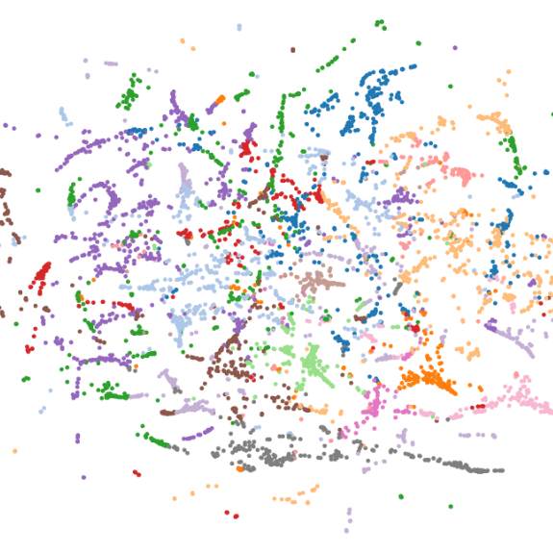
Why embeddings?
Find 100 clusters
(groups of neighboring words)
K-means clustering

Slide 15
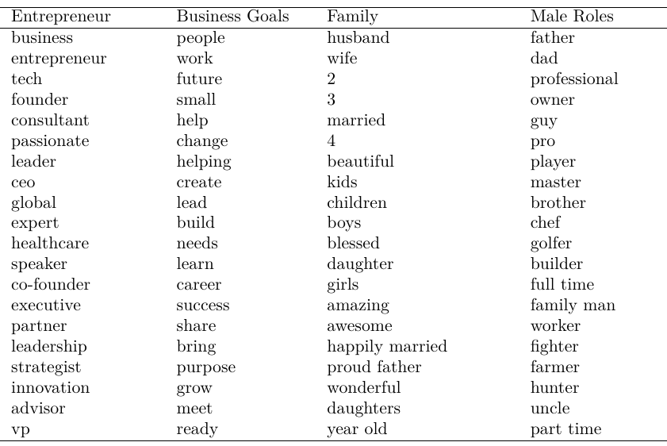

Slide 16
Why embeddings?
Answer questions like:
Are political identities are common in Twitter bios?
Are users' partisan/ideological identities are predictable based on their non-political identities?
Do users change their identities in the face of negative events?

Slide 17
Why embeddings?
Summing up: embeddings can be used for:
Improving supervised model performance
Investigating meaning
In both cases embeddings can be:
trained locally (on the current corpus)
pre-trained (on another larger corpus)
Notes:
In the case of a), if the embeddings are inputs for a supervised model, we will typically just build the embedding step into the model. So instead of training one model to embed words on this corpus, and then use those in another model to make predictions about the documents in the corpus, we'll make the first layer of the model learn embeddings. So the first layer will translate one-hot encoded word vectors into lists of a few hundred numbers.

Slide 18
Training: tasks and models
Credits:
McCormick, Chris. Word2Vec Tutorial.
Birajdar, Nikhil. GloVe Research Paper Explained. Towards Data Science.
Notes:
http://mccormickml.com/2016/04/19/word2vec-tutorial-the-skip-gram-model/
https://towardsdatascience.com/glove-research-paper-explained-4f5b78b68f89

Slide 19
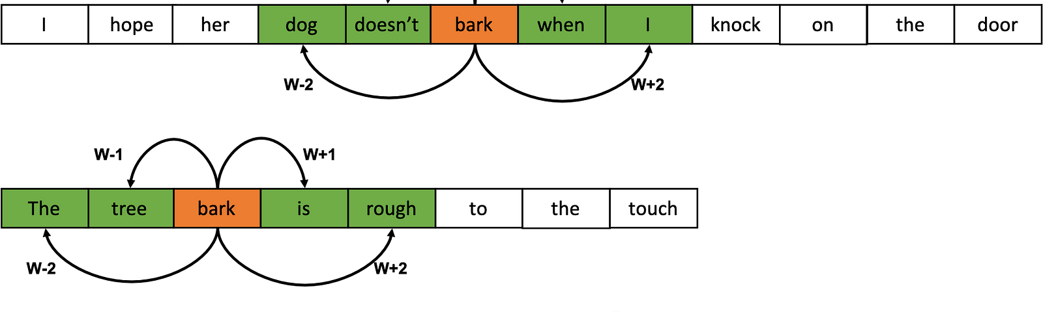
Training: tasks and models
Skip-gram task:
Randomly pick "context" word from the corpus.
Randomly pick "target" word from a window around the context word
Predict target word given context word
Notes:
The idea is that the model will learn to represent the context word in a way that's actually helpful to predict the target word. And those representations turn out to be useful and meaningful; they are word embeddings. (we'll get to the actual model in a minute). So just like with BERT and the masked word and next sentence prediction tasks, we're not teaching the model anything that's useful to do in the real world. Instead, we are tricking it into learning something useful through a useless task.
https://medium.com/analytics-vidhya/understanding-word2vec-39fabe660705

Slide 20
Training: tasks and models
Skip-gram task:
Randomly pick "context" word from the corpus.
Randomly pick "target" word from a window around the context word
Predict target word given context word
Notes:
Of course, models trying to do this task aren't going to perform very well. If we need to predict a target word from the context word "bark", then a whole bunch of words to do with dogs could be possible, and a ton of words to do with trees, plus a whole bunch of very common words (though we will get back to a way to deal with that). But the point is not the ultimate performance on this task. The point is that the weights in a model that tries to do this task will end up encoding something about the fact that bark apparently has something to do with dogs and trees. In other words, those weights will become word embeddings.

Slide 21
Training: tasks and models
Subsampling frequent words:
More frequent words are less likely to be sampled
Because:
As target words, they are just noise
As context words, they occur way more often than is needed to learn their meaning
Notes:
We won't learn anything about the context word bark if we are trying to use it to predict the target word "the"

Slide 22
Training: tasks and models
Negative sampling:
Randomly sample context and target word ("positive" example)
Keep context and randomly sample a non-target from the dictionary ("negative" example)
Present lots of pairs and have model guess which ones are positive and negative
Less computationally demanding
Notes:
Because we only have to calculate one output: probability of positive example. Rather than calculating a probability for every possible word in the vocabulary

Slide 23
Training: tasks and models
CBOW task: same but you get the whole context
Randomly pick target word from the corpus.
Take all context words from a window around the target word
Predict target word given all context words
Notes:
CBOW = continuous bag of words
https://medium.com/analytics-vidhya/understanding-word2vec-39fabe660705

Slide 24
Training: tasks and models
Mikolov et al. (2013)
word2vec embeddings
Skipgram or CBOW +
Subsampling frequent words +
Negative sampling +
A very simple model
Notes:
Mikolov et al.: Google researchers

Slide 25
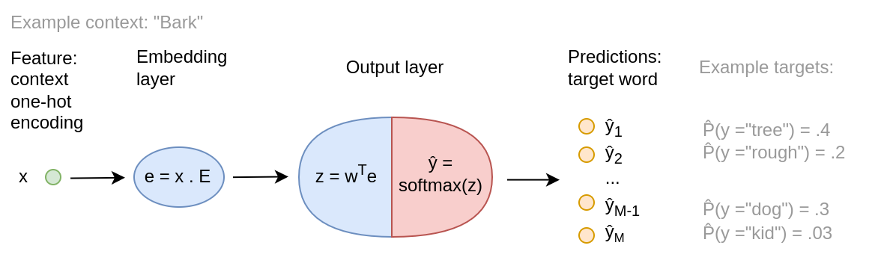
Notes:
(on blackboard): show how E . x just selects the row of the embedding matrix that corresponds to this word.

Slide 26
Training: tasks and models
Bojanowski et al. (2017)
FastText embeddings
Very similar to word2vec
Main difference: character n-grams as input
i.e. all sets of 3 to 6 neighboring letters inside the word
"<cats>" → "<ca", "cat", "ats>", "<cats", "cats>", "<cats>"
Notes:
Bojanowski et al.: Facebook researchers
"letters" include the start and end tag

Slide 27
Training: tasks and models
Bojanowski et al. (2017)
FastText embeddings
Two advantages:
Out-of-vocabulary words
Making use of shared morphology
Conjugations, singular/plural, misspellings etc.
Notes:
OOV words: just sum the embeddings of all their character n-grams, so hopefully the "underestimated", if it was never seen in the training data, would get an embedding quite close to "under" and "estimated"
(and yes, it is implemented in a way that makes it, in my experience, faster to train than word2vec)

Slide 28
Training: tasks and models
Bojanowski et al. (2017)
FastText embeddings
Results: better than word2vec at
representing word similarity
in all tested languages except English
solving syntactic analogies (cat : cats as dog : ?)
but not semantic analogies

Slide 29
Training: tasks and models
Pennington et al. (2014)
GloVe
Basic idea: find embeddings so that
the dot product of any pair of word embeddings
predicts
the frequency with which they co-occur (within X words of each other)
Notes:
Pennington et al. (2014): Stanford researchers

Slide 30
Training: tasks and models
Pennington et al. (2014)
GloVe
Results: better than word2vec at
representing word similarity
solving both semantic and syntactic analogies

Slide 31
Training: tasks and models
BERT: contextual embeddings
Output of each encoder represents each of the input words using numbers
= embeddings
Attention layers cause embeddings to contain information from surrounding words
Notes:
https://medium.com/@dhartidhami/understanding-bert-word-embeddings-7dc4d2ea54ca

Slide 32
Limitations and bias

Slide 33
Bias and limitations
Limitations:
Homographs ("bark" and "bark")
Instability
Tricky to validate
Notes:
Word2vec, FastText and GloVe cannot learn that there are two words spelled "bark" that have completely different meanings. (BERT can do this)

Slide 34
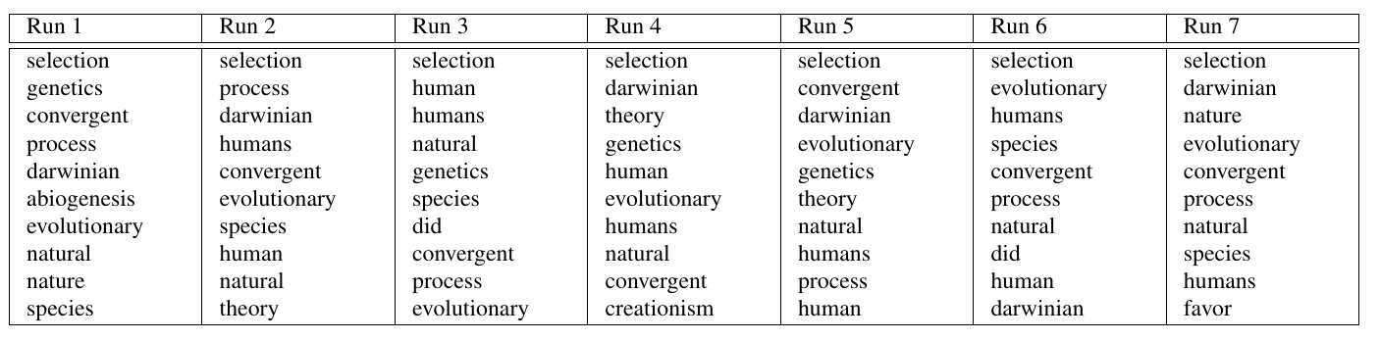
Limitations and bias
Antoniak & Mimno (2018)
Instability
Notes:
The order of the 10 closest words to the query term evolution are highly variable. GloVe embeddings on the full corpus of the AskScience subreddit.

Slide 35
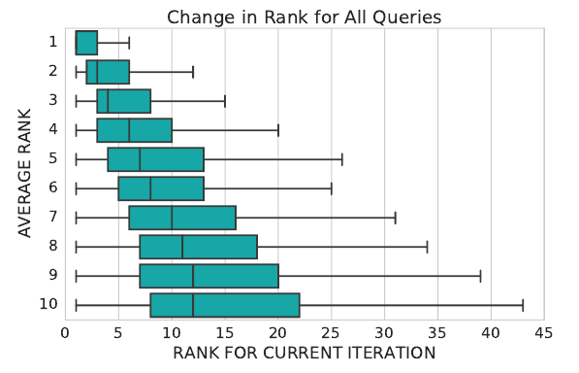

Slide 36
Limitations and bias
Tricky to validate
Automated validation tasks (see above):
Retrieving known similar words
Solving known analogies
Problems:
Might want performance in a certain domain
Only available for some languages

Slide 37
Limitations and bias
Tricky to validate
Turing performance (Rodriguez & Spirling 2021):
Get human- and embedding-generated list of closest neighbors to a word
Let crowd-workers choose between then
Problems:
Crowd does not know corpus
Expensive to repeat many times
Notes:
So you might be training your word embeddings locally on your own, say Twitter corpus, and it might turn out that one of the most similar words to Trump is train. That's because of the expression "trump train", but a crowd worker who doesn't know Twitter might not know that. Or your corpus might be from a particular period in time, whereas your coders will be thinking of present-day associations.

Slide 38
Limitations and bias
Bias in embeddings
Gender bias in word2vec trained on Google News (Bolukbasi et al. 2016)
Also GloVe
Notes:
Just like other language models, embedding models learn all of the associations present in the text we feed it, whether we would like to reproduce those associations or not.

Slide 39
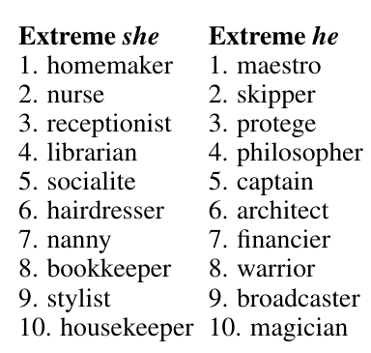
Limitations and bias
Bias in embeddings
Occupations are closer to "he" or "she" depending on their stereotypical gender association

Slide 40
Limitations and bias
Bias in embeddings
Analogies are solved in undesirable ways

Slide 41
Limitations and bias
Proposed solution (works for all binary social categories):
Find all words that have gender in their definition (e.g. he-she, man-woman, businesswoman-businessman)
Use those to identify a "gender direction" in the embedding space

Slide 42
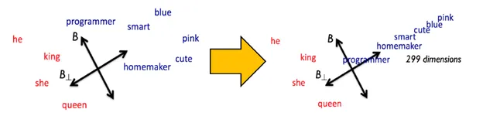
Limitations and bias
3. Make a projection so that all words without gender in their definition have a zero value on the gender dimension
Notes:
https://towardsdatascience.com/man-is-to-computer-programmer-as-woman-is-to-homemaker-e57b07cbde96. Manzini et al. (2019) extended this method to cases with more than two social categories that we want to equalize, like race or religion.

Slide 43
Next class preview

Slide 44
Sentence classification: content
Sentiment analysis
Transfer learning
Capturing social science concepts in language:
Error and bias in annotations
Bits and bobs

Slide 45
Sentence classification: readings
GRS chapter 17 and 18 (both short)
Terechshenko et al. (2020). A comparison of methods in political science text classification: Transfer learning language models for politics.
Felbo, et al. (2017) Using millions of emoji occurrences to learn any-domain representations for detecting sentiment, emotion and sarcasm. (skim)

